Slide 1
Chapter 8. Graphs
Part 1

Slide 2
Objectives
Graph
Definition & Terminology
Applications
Representation
Traversals
Connectivity
Cycle Detection
Shortest Path
Dijkstra Algorithm
Floyd Algorithm

Slide 3
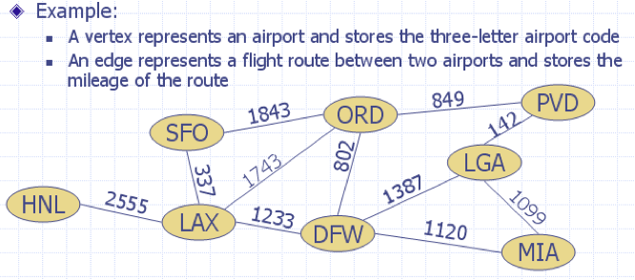
Graph definition
Graph: a pair (V, E):
V: set of nodes (Vertices)
E: collections of pairs of vertices (Edges)
⇒ Graph is a collection of vertices and the connections between them.
Example:

Slide 4


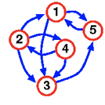

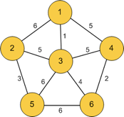

Graph Terminology - 1
Undirected graph: Graph G=(V, E) with each edge e being a set of two vertices from V ( e = {u,v} ).
Directed graph(or a digraph): G=(V, E) with each edge e is an ordered pair of vertices from V ( e = (u,v) ).
Note: In directed graph the pair (u,v) is not the same as the pair (v,u).
Weighted graph: G=(V, E) with each edge e has an assigned number, called the weight of the edge e.

Slide 5
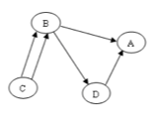
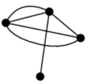
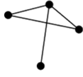
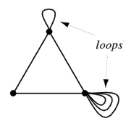
Graph Terminology - 2
4. Multiple and single edges:
Multiple edges: Two or more edges connecting the same two vertices
Single edges: Only one edges connecting the same two vertices
Graph with multiple edge
b. Graph with single edge
5. Graph loops: Edge which joins a vertex to itself (also called a self-loop)

Slide 6
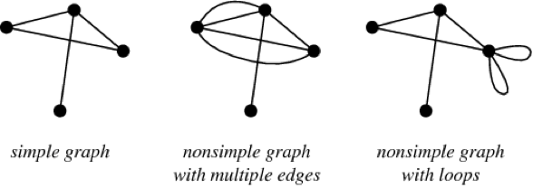
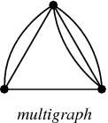
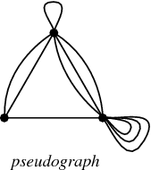
Graph Terminology - 3
6. Simple graph (strict graph): an unweighted, undirected graph containing no graph loops or multiple edges
Note: the unqualified term "graph" usually refers to a simple graph.
7. Multigraph: graph with two vertices (with the condition v_{i} ≠ v_{j}) can be joined by multiple edges
8. Pseudograph: multigraph but without condition v_{i} ≠ v_{j}
Note: pseudograph allows for loops to occur

Slide 7
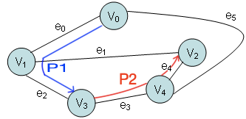
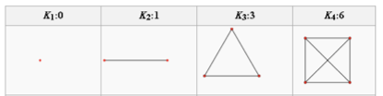

Graph Terminology - 4
9. Path from v_{i} to v_{n} is a sequence of edges (v₁,v₂), (v₂,v₃),.., (v_{n-1},v_{n}). If v₁=v_{n} and no edge is repeated, then the path is called a circuit.
10. Complete graph: Every pair of vertices is connected by an edge.
Note: Complete graph with n vertices has n vertices and n(n-1)/2 edges, and is denoted by Kn
11. Subgraph: G'=(V', E') is a subgraph of another graph G=(V, E) ⇔

Slide 8
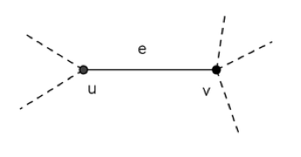
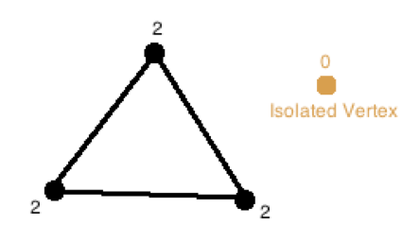
Graph Terminology - 5
12. Vertice u and v are called adjacent ⇔ edge e = (u,v) in E.
13. Edge e = (u,v) are called incident with u and v ⇔ u and v are adjacent.
14. Degree of a vertice u (deg(u)) is the number of edges incident with u.
Note: If deg(u) = 0 then u is called isolated vertex.
Adjacent vertices and incident edge
A
D
B C

Slide 9
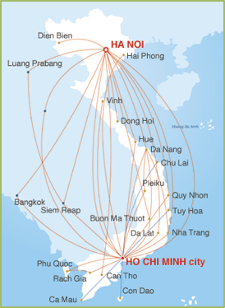
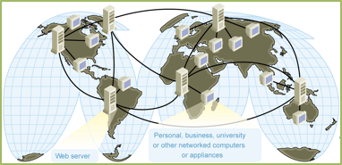
Graph applications
•Electronic circuits
•Transportation networks
•Computer networks
•Database
–Entity-relationship diagram

Slide 10
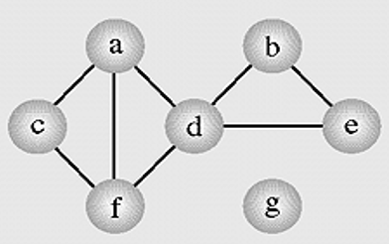
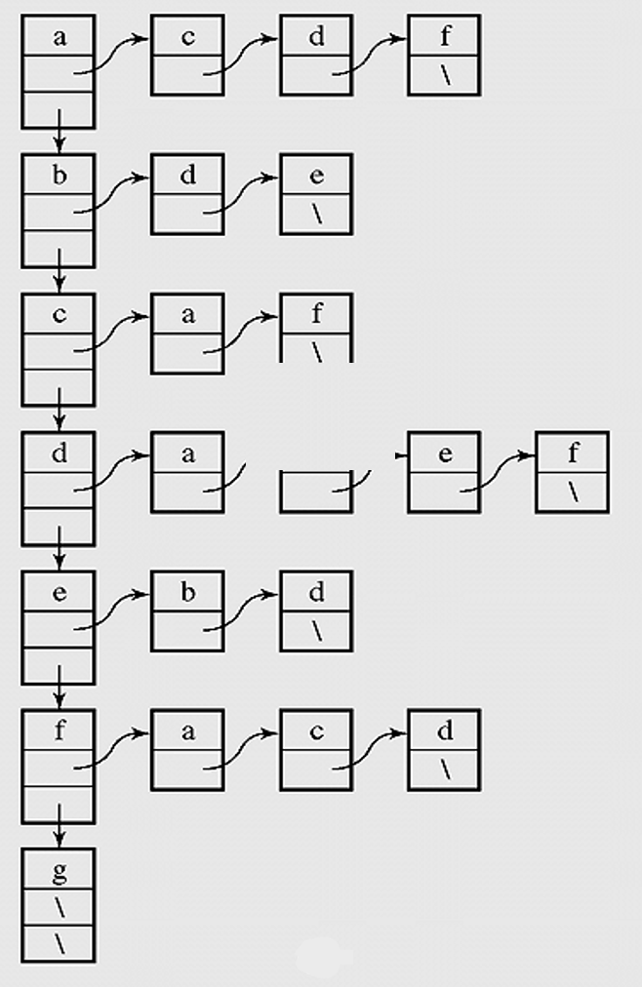
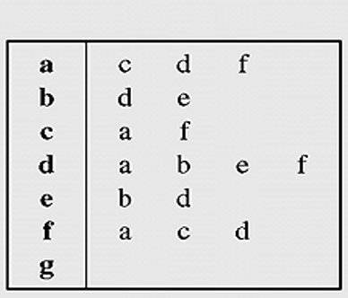
Graph Representation – 1
(Adjacency list)
- Graph a can be represented as table b and list c.
Graph
b. Adjacency list with table
c. Adjacency list with list

Slide 11
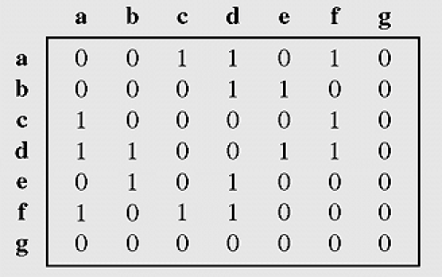
Graph Representation – 2
(Adjacency matrix)
Graph represented by an adjacency matrix

Slide 12
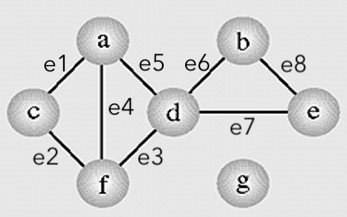
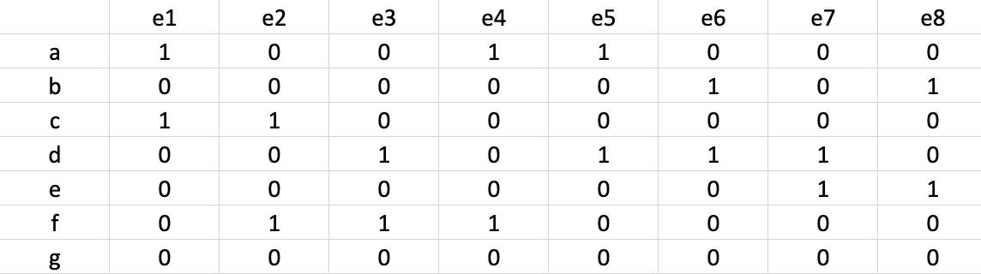
Graph Representation – 3
(Incident matrix)
Graph represented by incident matrix

